Slide 1


Effects of Sub-Atmospheric Pressures on the Temperature Evolution of Spark Kernels
Daniel Caplan and David Blunck, PhD.
SciTech, 8-12 January 2018
Kissimmee, Florida
GTE-07, Control ID 2795470

Slide 2
Introduction
How sub-atmospheric pressure affects:
the temperature
Fluid mechanics
Other characteristics

Slide 3
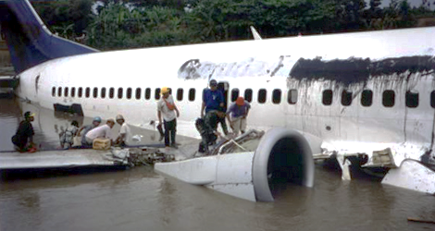
Why Study Low Pressure Ignition?
High altitude re-ignition
Afterburner ignition
When?
Garuda Indonesia Flight GA421 wreckage after dual engine flameout induced by inclement weather [1]

Slide 4
How is Ignition Studied?
4

Slide 5
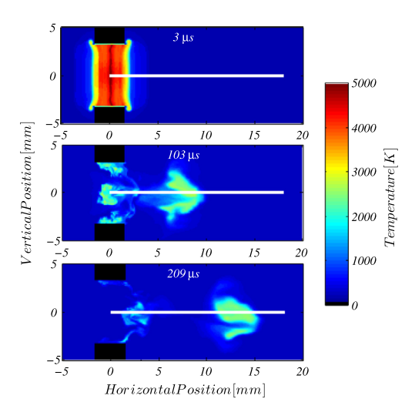
Numerical Modeling
Another Modeling Example
Do I need permission to use this from another published paper??
Modeled spark kernel in a cross flow of air. [2]

Slide 6
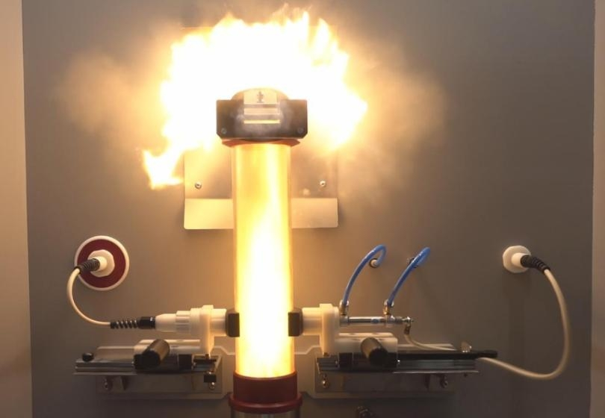
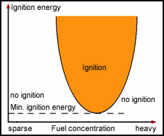
Minimum Ignition Energy (MIE)
MIE Test Rig [3]
MIE Graphical Representation [4]

Slide 7
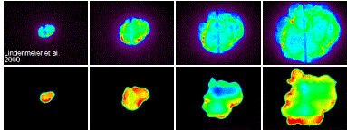
Spark Kernels: Reacting
Chemiluminescence
Do I need permission to use this from another published paper??
Also, this was found on a website but I’m not sure what paper they got it from….
OH* PLIF
Chemiluminescence and OH* Planar Laser Induced Fluorescence (PLIF) images of spark ignition in a piston engine. [5]

Slide 8
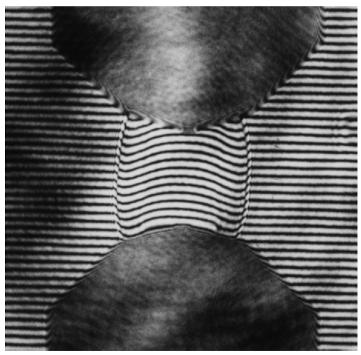
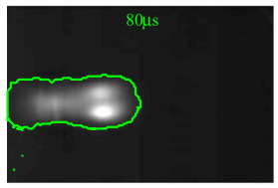
Spark Kernels: Non-Reacting
Do I need permission to use this from another published paper??
Do I need permission to use this from another published paper??
Interferogram photograph of a spark kernel shock wave in nitrogen. [6]
Laser-Schlieren image of a spark kernel in a crossflow of air. [2]

Slide 9
The Experiment
9

Slide 10
Goals
Is this slide needed?
How sub-atmospheric pressure affects
temperature
fluid mechanics
other characteristics

Slide 11

Deconvolution Technique
Radiation transfer equation for a participating medium:
Sdfsadf sadfssadf
Spectral Intensity
Assdfasdf sadfsaaf
( )
Composition
Path Length
Temperature
Pressure
Solve for temperature, measuring everything else
Intensity = function of

Slide 12
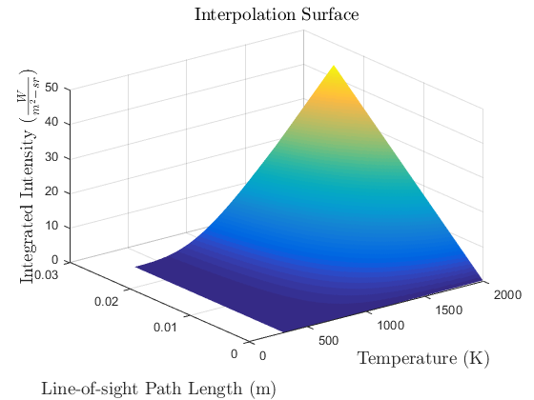
Temperature Interpolation Surface
Update Plot
Built using Radcal [7]
For each combination:
Composition
Pressure

Slide 13
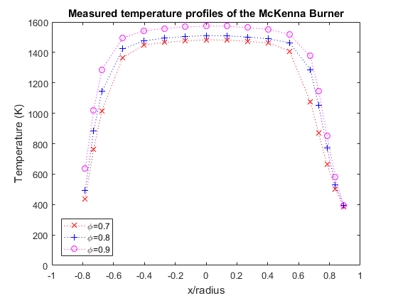
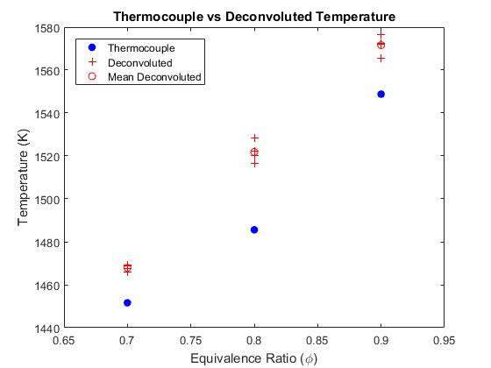
Technique Evaluation
Percentages Plot

Slide 14
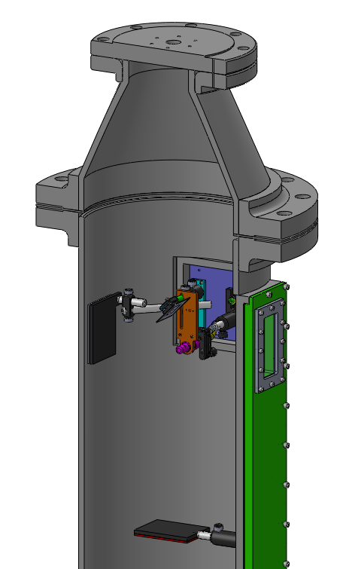
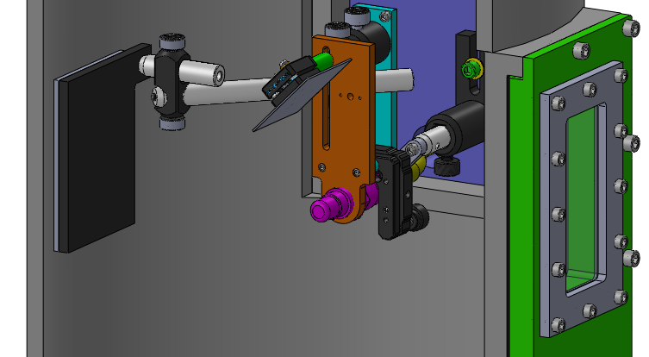
Experimental Setup
Vacuum Pump
Gas Analyzer
Mirror
Camera
Igniter
Heated Back Plate
Sapphire Window
Heated Back Plate
CAD images of igniter jig inside vacuum chamber

Slide 15
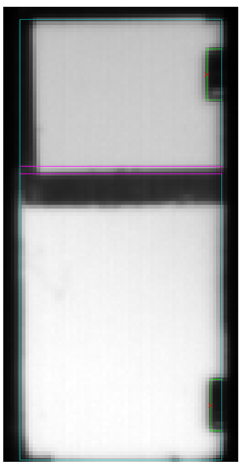
Experimental Setup
Photo of chamber with igniter inside
Animate with video

Slide 16
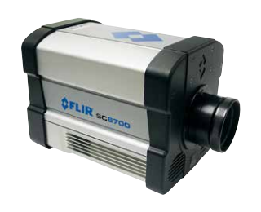
Data Collection
Camera: FLIR SC6700
MWIR InSb Detector, 1-5 μm
Blackbody calibrated
~1500 Hz
Gas Analyzer: as;lfdkjsa;ldkfj;sadkf
H2O and CO2 concentrations
Ambient Temperature and Pressure
FLIR SC6700 IR Camera [7]
Gas Analyzer Picture

Slide 17
Image Processing
17

Slide 18
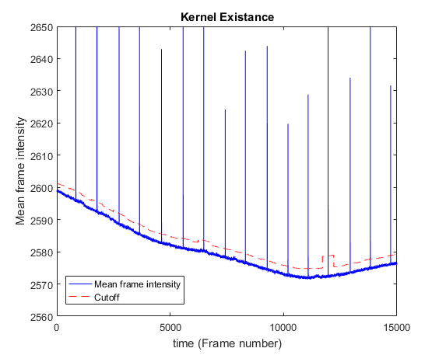
Finding Kernels in the Data
Is this slide needed?

Slide 19
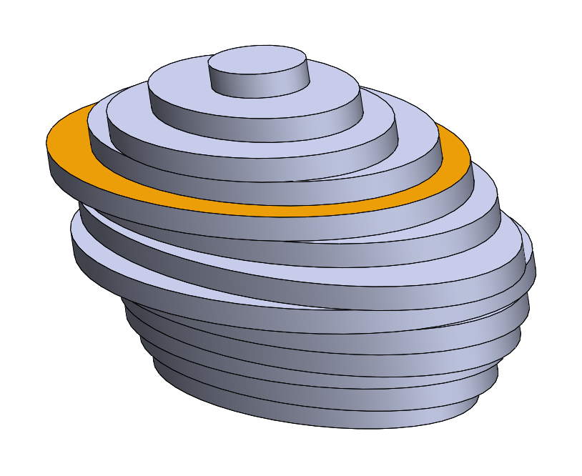
Determining Path Length
Mirror
Depth Axis
Reflected
Camera
Kernel approximated as stack of ellipse slices
Width
Axis
Line of Sight

Slide 20
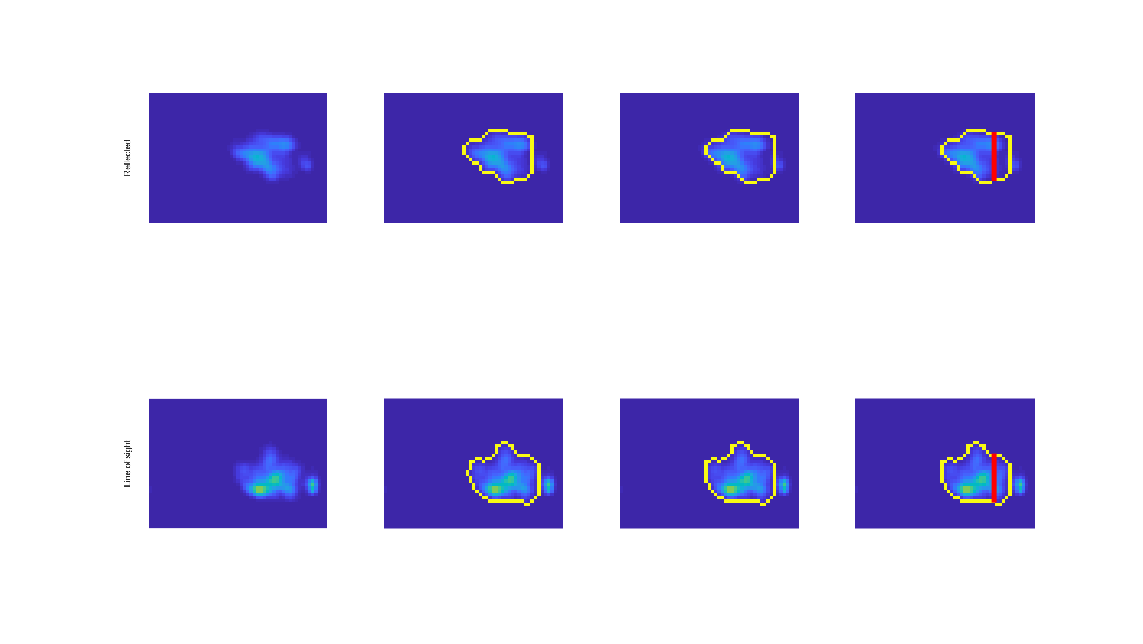
Determining Ellipse Axes
Reflected
Igniter Tip
Line of Sight
Kernel Intensity
Edge Detection
Align Tip
Ellipse Axes
Notes:
2017_12_19, DP8, {1,1}

Slide 21


Intensity to Temperature
Intensity image…
Temperature imge…

Slide 22
Kernel Intensities
1.0 atm video
0.6 atm video
0.3 atm video
lower radiation emissions
shorter detectable duration
splits up more
more material ablation
At Lower Pressure:

Slide 23
Kernel Temperatures
1.0 atm video
0.6 atm video
0.3 atm video
Lower temperatures
sdsdfa
At Lower Pressure:

Slide 24
Phase Average Temperature
1.0 atm

Slide 25
Phase Average Temperature
0.6 atm

Slide 26
Phase Average Temperature
0.3 atm

Slide 27
Average Temperature
1.0 atm
0.6 atm
0.3 atm

Slide 28
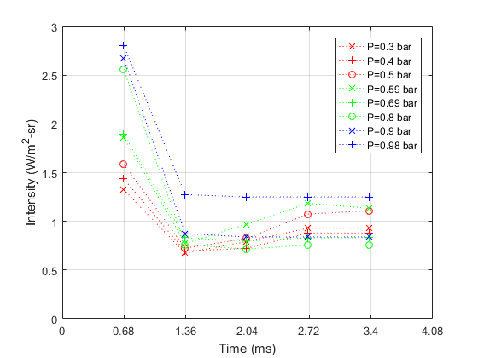
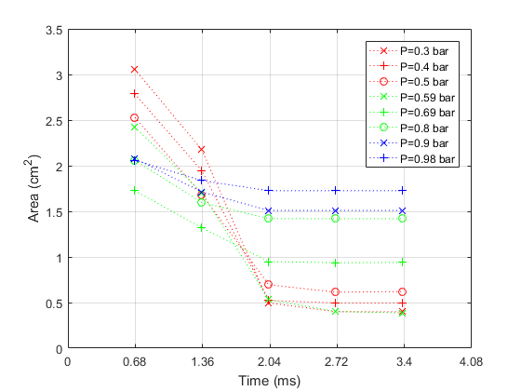
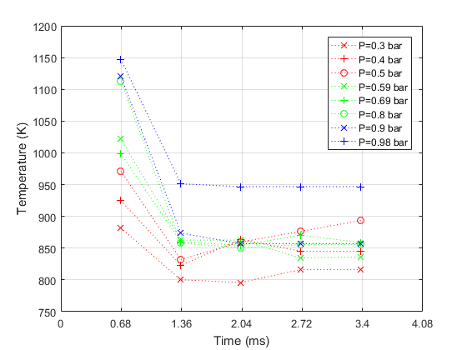
Kernel Averages
Update Plots:
Line/marker styles and colors
Font sizes
Data

Slide 29
Key Takeaways
At Lower Pressure,
Lower Radiation Emissions
Lower Temperatures
More Material Ablation

Slide 30
Acknowledgements
Air Force Research Laboratory (Craig Neuroth) for use of igniter equipment
Oregon State University for funding
OSU Propulsion Laboratory (Jonathan Bonebrake and Nathan Schorn) for use of the vacuum chamber
Chad Higgins for use of the gas analyzer
Bryan Cmelak and Tyler Castile for help with manufacturing and data collection

Slide 31
Sources
[1] http://www.aviation-accidents.net/garuda-indonesia-boeing-b737-300-pk-gwa-flight-ga421/
[2] Sforzo, B., Lambert, A., Kim, J., Jagoda, J., Menon, S., and Seitzman, J., “Post discharge evolution of a spark igniter kernel,” Combustion and Flame, Vol. 162, No. 1, 2015, pp. 181–190.
[3] http://anko-lab.com/en/a/apparatus-for-determination-of-minimum-ignition-energy-of-a-dust-air-mixtures
[4] http://www.exschutz.net/en/basic-information-on-explosions.html
[5] http://www.itt.kit.edu/english/323.php
[6] Reinmann, R. and Akram, M., “Temporal investigation of a fast spark discharge in hemically inert gases,” Journal of Physics D: Applied Physics, Vol. 30, No. 7, 1997, pp. 1125.
[7] Grosshandler, W. L., “RADCAL: A Narrow-Band Model for Radiation Calculations in a Combustion Environment,” 1993.
[8]

